Slide 1
Unsearch
Leveraging Google Instant results

Slide 2
Google Instant
Google Instant displays the result of your most probable search
You receive the result before you made the search
A query is logged as a search only if¹:
You click anywhere on the page (a search result, an ad, a spell correction, a related search).
You click on the Search button, press Enter, or select one of the predicted queries.
You stop typing for a minimum of three seconds.
Instant logs are kept 2 weeks² vs 18 months for regular searches.
1: http://adwords.google.com/support/aw/bin/answer.py?hl=en&answer=187309
2: http://peterfleischer.blogspot.com/2010/09/privacy-numbers-game.html

Slide 3
Unearch- Basic
Objective: When a user accepts an instant suggestion (interact with the result), Unsearch keeps typing in the search bar so user’s search is not logged
How It Works
Unsearch intercepts the event (click, mouse move,…), Google does not log the query.
Unsearch copies the results from Google Instant (user get normal search results)
The search result page is parsed to remove ‘click-through’ redirects (except for ads)
The user interacts with the search result copied from ‘instant’ while Unsearch is still completing the search
Google only logs the full query typed by Unsearch
TMN eventually clicks on a search result

Slide 4
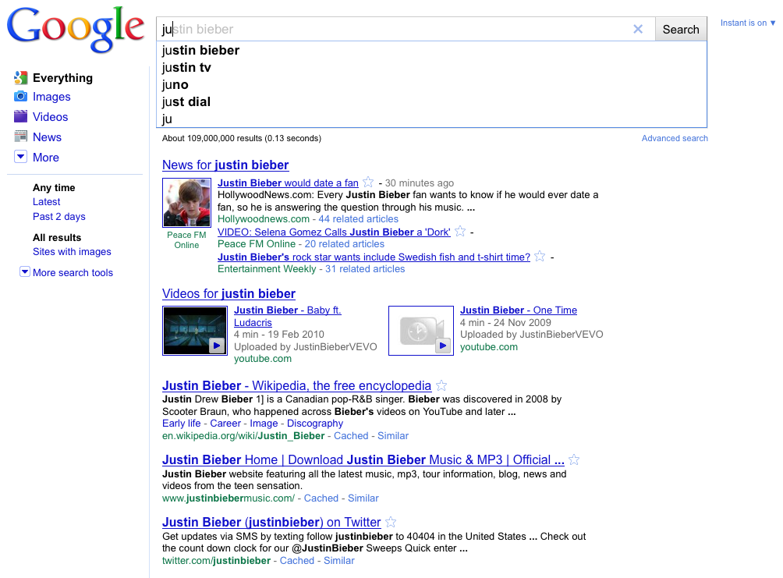
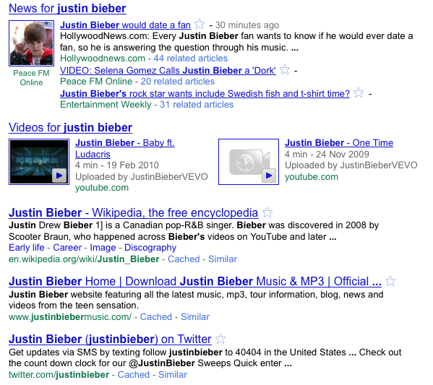
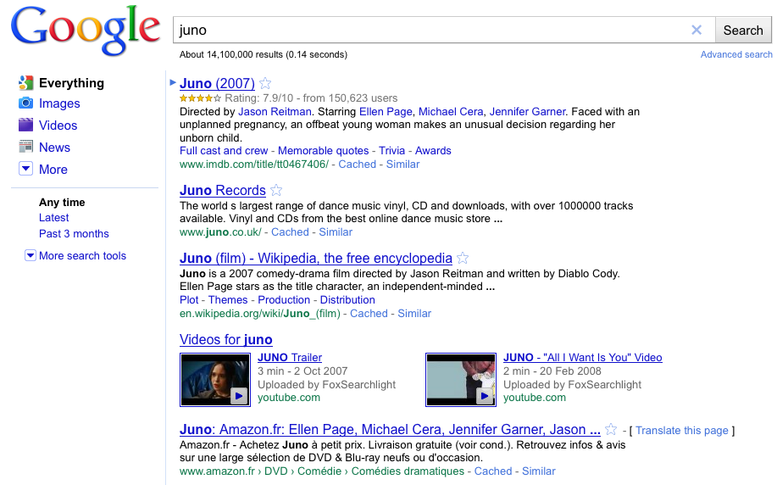
Basic example
The user wants to search for ‘Justin Bieber’ but does not want Google to know.
1) The user types “ju” in the search bar and move the mouse
2) Unsearch captures the mouse event, copy the result page and shows the copy to the user
3) In Background, Unsearch types ‘no’ in the original search bar and then clicks on search

Slide 5
Rare queries (n-gram)
Since Google Instant show the most probable query results, rare query won’t get results.
User has to type the full query in the search bar to get result.
When the user interacts with the results
Unsearch first remove keywords (or letters) from the search bar
Unsearch completes the search in a different way

Slide 6
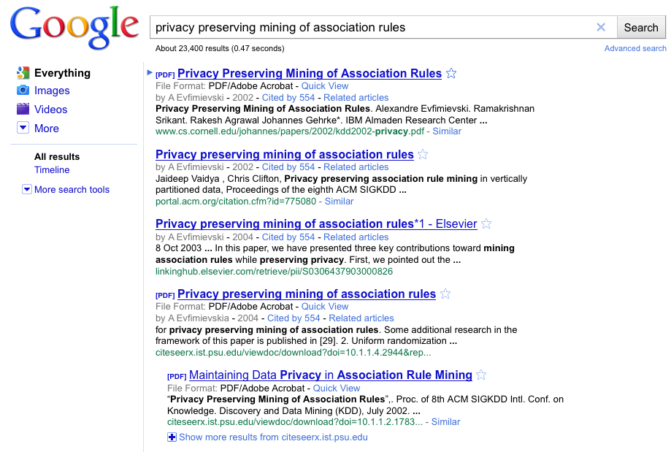
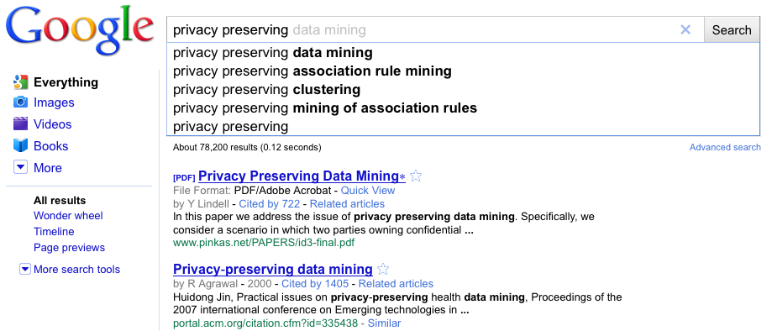
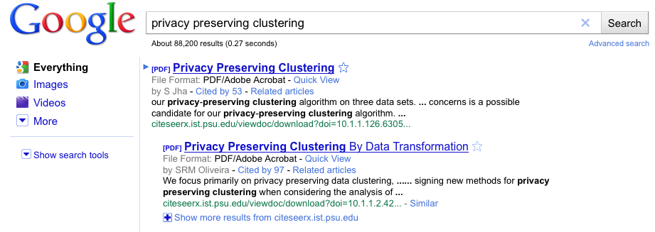
Complex examples
1) The user types full query in the search; Unsearch copies the results
2) In Background, Unsearch removes some keywords
3) And then Unsearch completes the query

Slide 7
Drawbacks and Open issues
Unsearch assumes that the user click only on one of the first 10 results
Makes search personalization harder.
Google could filter queries where user start removing keywords.
Users must first select the type of content (image, video, news,…) and then search
How to manage search sessions?
Lack of documentation about Google Instant logs
Would Google change the Instant policy?

